Slide 1
Database System
CL 203
Lab 02
Functions, Dates ,Operators And Group of data

Slide 2
ORACLE BUILT-IN FUNCTIONS
Functions are a very powerful feature of SQL and can be used to do the following:
Perform calculations on data
Modify individual data items
Manipulate output for groups of rows
Format dates and numbers for display
Convert column data types

Slide 3
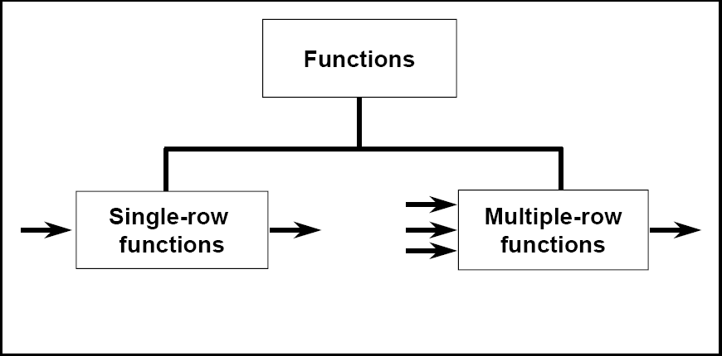
Types of Functions
Single-row functions
Multiple-row functions/Group Functions/Aggregate Functions

Slide 4
Types of Single Row Functions
1) Numeric Functions
These are functions that accept numeric input and return numeric values.
2) Character or Text Functions
These are functions that accept character input and can return both character and number values.
3) Date Functions
These are functions that take values that are of datatype DATE as input and return values of datatype DATE, except for the MONTHS_BETWEEN function, which returns a number.
4) Conversion Functions
These are functions that help us to convert a value in one form to another form. For Example: a null value into an actual value, or a value from one datatype to another datatype like NVL, TO_CHAR, TO_NUMBER, TO_DATE etc.

Slide 5
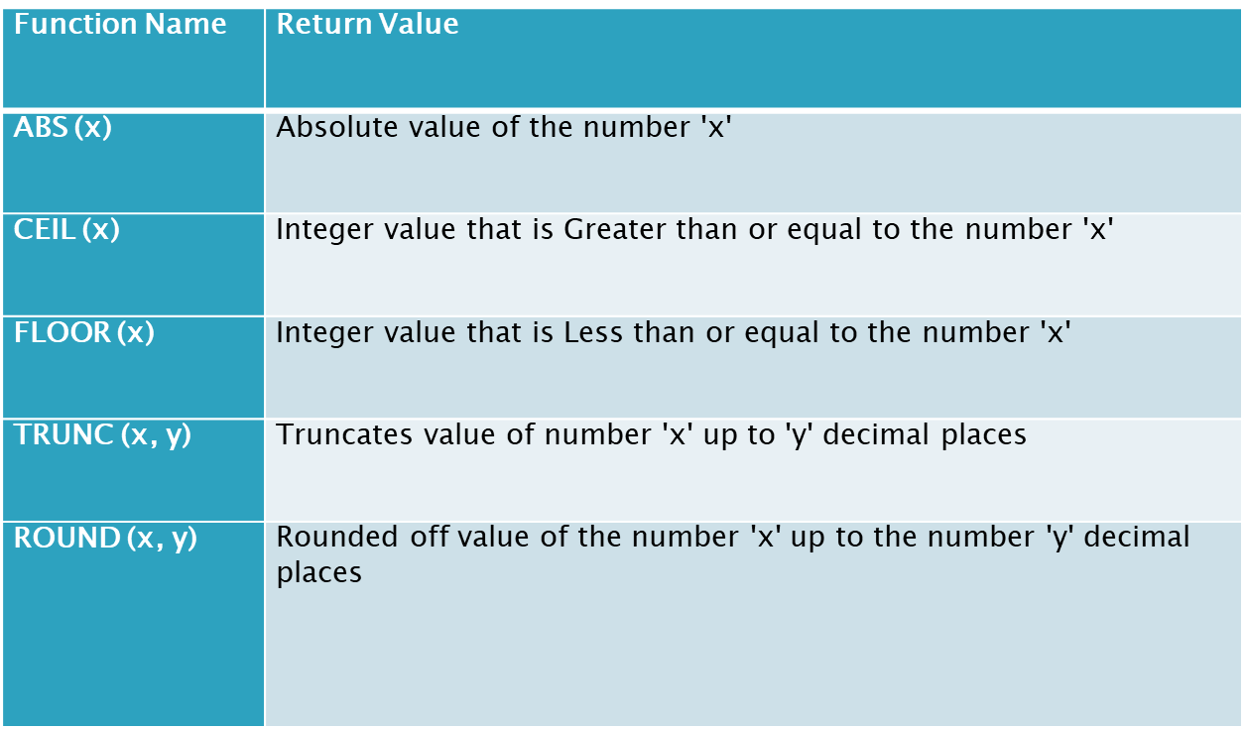
Numeric Functions

Slide 6
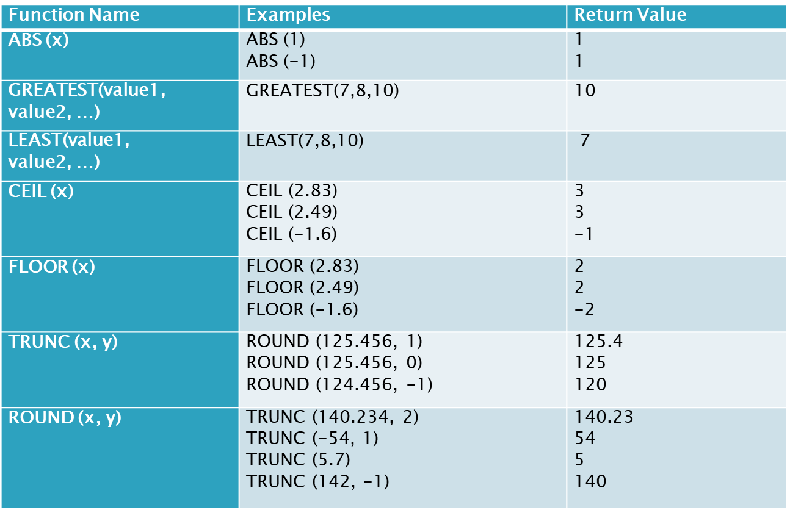
Numeric Functions Example

Slide 7
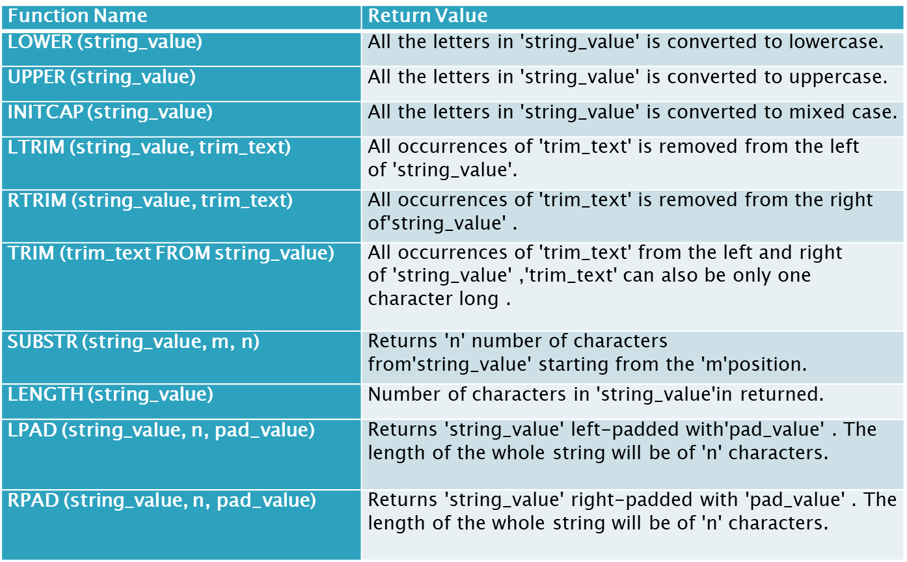
Character Functions

Slide 8
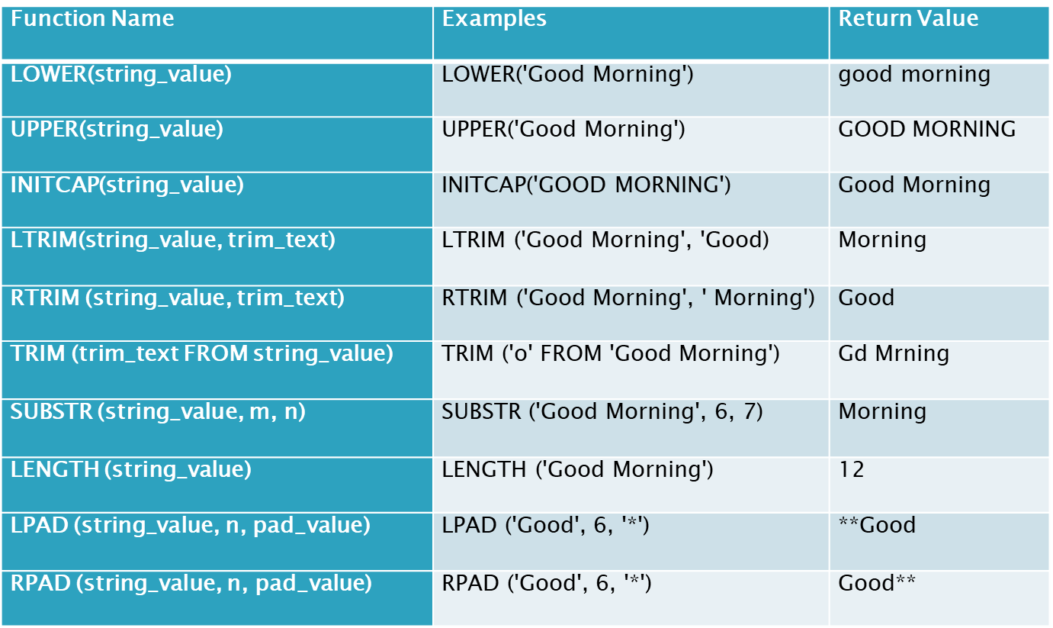
Character Functions Example

Slide 9
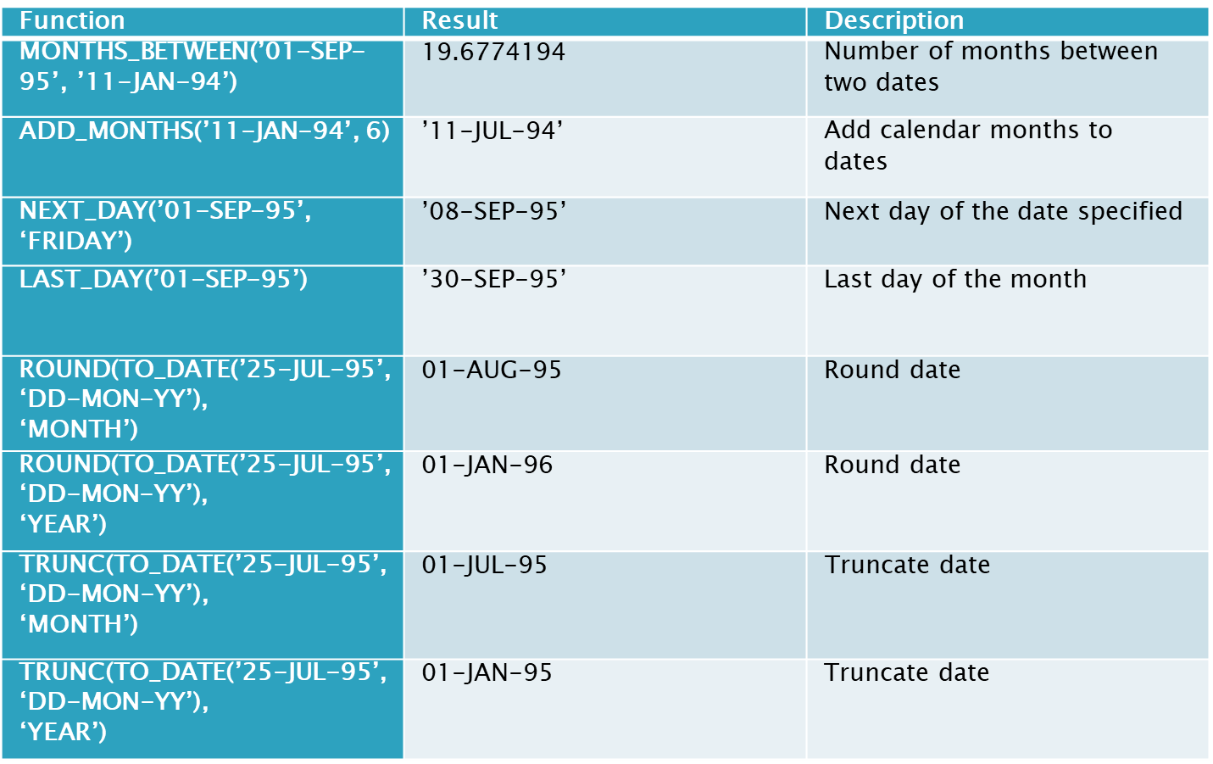
Date Functions

Slide 10
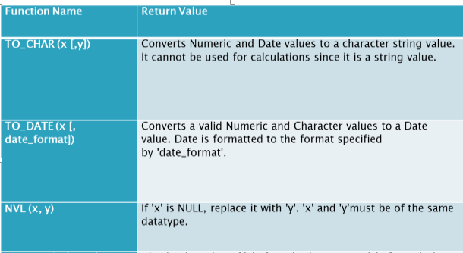
Conversion Functions

Slide 11
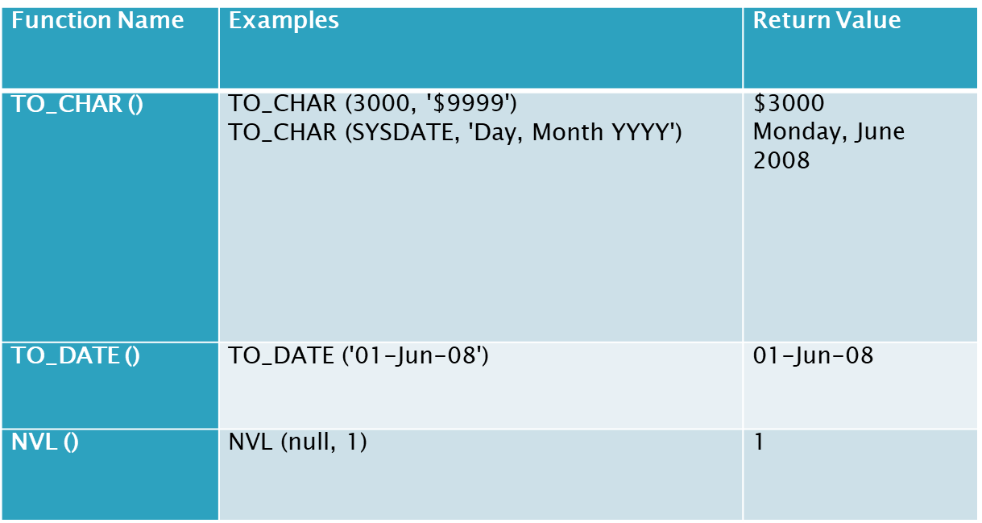
Conversion Functions Example

Slide 12
Arithmetic Operators
Simple Computation:
SELECT 2*6 FROM dual;
Dual: Dummy Table
Date Arithmetic:
Select TO_DATE (’31-jul-2012’) + 2 FROM DUAL;
Select TO_DATE (’02-AUG-2012’) – TO_DATE (’31-JUL-2012’) FROM dual;
To_Date: A function that converts string into date

Slide 13
Conversion Of NULL values
SELECT ename,NVL(comm,0),NVL2(comm,sal+comm,sal)as Income FROM emp;
NVL converts a NULL value to an actual value in this e.g to zero
NVL2: if commission is not null then return salary + commission else if commission is Null then return salary

Slide 14
Rownum Operator:
Used to display certain number of rows
SELECT column_name(s) FROM table_name WHERE ROWNUM <= number
SELECT EMPNO, ENAME, DEPTNO FROM EMP WHERE ROWNUM <= 3;

Slide 15
Group By Statement
The GROUP BY statement is used in conjunction with the aggregate functions to group the result-set by one or more columns.

Slide 16
SQL GROUP BY Syntax
SELECT column_name, aggregate_function(column_name) FROM table_name WHERE column_name operator value GROUP BY column_name

Slide 17
Group By Examples
To show the department-wise average salary
SELECT deptno, AVG(sal) AVERAGE_SALARY
FROM emp GROUP BY deptno;
To show the job-wise total salary for each department
SELECT deptno, job, sum(sal) FROM emp
GROUP BY deptno, job;

Slide 18
Having Clause
In the same way that we use the WHERE clause to restrict the rows that we select, the HAVING clause is used to restrict groups. First the group function is applied and the groups matching the HAVING clause are displayed.

Slide 19
Syntax
SELECT column, group_function
FROM table
[WHERE condition]
[GROUP BY group_by_expression]
[HAVING group_condition]
[ORDER BY column];

Slide 20
Having Examples
To show the department-wise average and maximum salary, in the descending order of average salary, for all departments having average salary higher than 2000.
SELECT DEPTNO, AVG(SAL), MAX(SAL) FROM EMP
GROUP BY DEPTNO HAVING AVG(SAL) > 2000
ORDER BY AVG(SAL)
To display the job title and total monthly salary for each job title with a total payroll exceeding 5000.
SELECT JOB, SUM(SAL) PAYROLL FROM EMP GROUP BY JOB HAVING SUM(SAL) > 5000 ORDER BY SUM(SAL);

